Slide 1

WIPRO NGA Program – Mobile Application Engg
Capstone Project Presentation – 4th Sep & 5th Sep 2025
Project Title Here - Add File Associations via MSI
Presented by – Kamran Akmal, Tejas Zinjade, Gaddapara Chenchu Umasree, Shrawani Balwadkar
www.rpsconsulting.in

Slide 2



Introduction
Today, we’ll explore how to configure MSI packages to automatically associate applications with the file extension (Like .pdf, .zip) during installation.
This ensures consistent user experience, standardized deployments, and reduces manual post-installation configuration.
File associations ensure that specific file types (like .pdf) always open with the correct application.
In enterprise environments, standardizing default apps improves usability and reduces helpdesk tickets.
Using Advanced Installer, we can easily manage file associations without manually editing registries.
2024 - RPS Consulting all rights reserved

Slide 3
Objective
Configure Foxit Reader MSI to automatically associate .pdf files.
Deploy the package in a way that ensures every user gets the correct default app.
Provide a repeatable, automated, and secure packaging process.
Eliminate the need for manual user intervention post-installation.
Method | Description | Tools Required
1. Advanced Installer (MSI File Associations) | Use Advanced Installer GUI to add .pdf association directly in the MSI package. | Advanced Installer
2. Orca / MST Transform (FileAssoc Table) | Modify the MSI File-Assoc table. | Orca, Inst-Ed
3. Registry Keys via MSI (HKCR & HKLM) | Add custom registry entries inside MSI (e.g., .pdf → FoxitReader.Document). | Orca, Advanced Installer
2024 - RPS Consulting all rights reserved

Slide 4



Tools & Resources Required
Advanced Installer: GUI-based MSI editor to configure file associations.
Orca / InstEd: Optional tools for deeper inspection of MSI tables.
Testing Environment: Clean VMs running Windows 10/11.
Deployment System: SCCM / Intune / Group Policy for distribution.
Administrative Access: Required for installing and validating file association changes.
Foxit PDF Reader MSI: Vendor-provided installer.
2024 - RPS Consulting all rights reserved

Slide 5
Minimum Requirements
System Requirements-OS:
Windows 10/11, or Windows Server 2016+
Disk: At least 10 GB free for repackaging/testing
Rights: Local admin privileges for packaging workstation
Software Tools
Advanced Installer (primary packaging tool)
Windows registry editor (for validation)
Log analysis (MSI logs, PowerShell for troubleshooting)
2024 - RPS Consulting all rights reserved

Slide 6
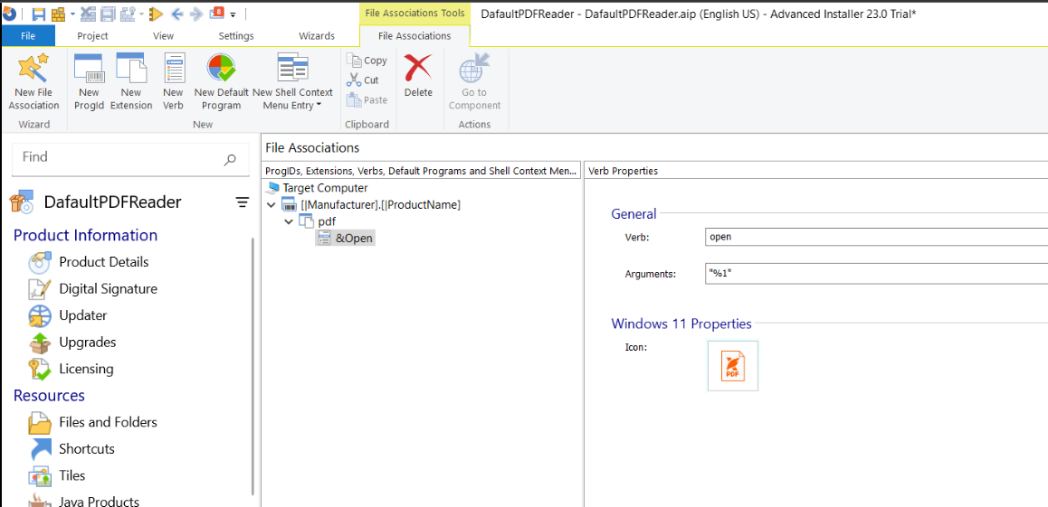
Execution Overview of Associating File With MSI
Extention Creation
The pdf Extention
Setting The verb to Open it will open .pdf files via FoxitPDF Reader
Set Default Application Command
2024 - RPS Consulting all rights reserved

Slide 7
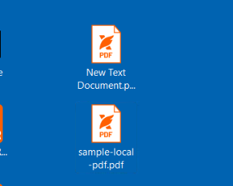
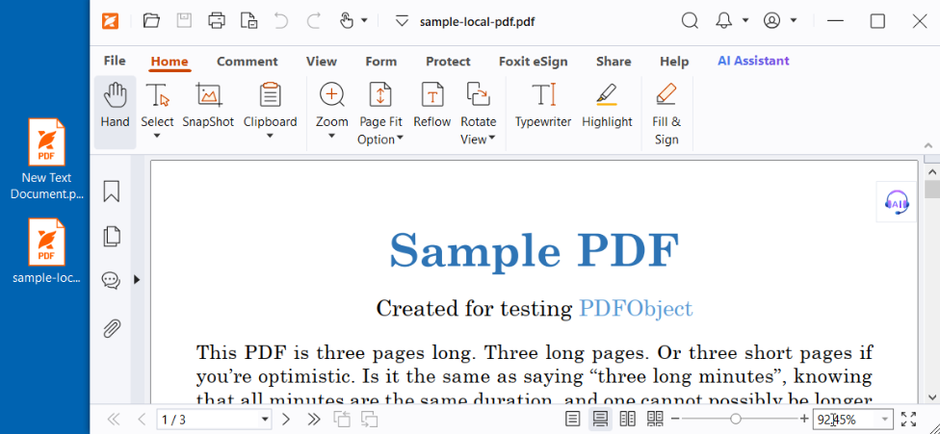
The Icon Change to as we set in Advance Installer
After Clicking on .pdf file it opens via FoxitPDFReader
2024 - RPS Consulting all rights reserved

Slide 8
References
Advanced Installer User Guide – File Associations
https://www.advancedinstaller.com/user-guide/file-associations.html
Windows Installer Documentation
https://learn.microsoft.com/en-us/windows/win32/msi/windows-installer-portal
Foxit Documentation
https://help.foxit.com/manuals/pdf-reader
MSI-Exec Commands Reference
https://learn.microsoft.com/en-us/windows-server/administration/windows-commands/msiexec
2024 - RPS Consulting all rights reserved

Slide 9


Thank You
Thank you for your time!
This project ensures seamless PDF handling across enterprise systems, reduces support calls, and enhances user productivity.
Questions?
2024 - RPS Consulting all rights reserved

